Slide 1
University of Basrah
AL-Zahraa College of Medicine
Ministry of higher Education and Scientific Research
Cardiorespiratory Care Block
Lecture title:heart failure
Date: 2/2/2022
Dr. Mohammed Adel
CRC Block Staff:
Dr Firas Rashid Sayil (block leader)
Dr. Mohammed Adil
Dr Assad Hassan
Dr Ahmed Qassim
Dr Safa Asaad
Dr Mustafa Ghazi
Dr Ilham Mohammed
Dr Zainab Muzahim
Dr. Ahmed Bader
Dr Nawal Mustafa
Dr Zainab Almnaseer
Dr Farqad Alhamdani
Dr Ban M. Saleh
Dr Amani Namaa
References as in the workbook and classroom.
For more detailed instruction, any question, cases need help please contact block leader at the CRC Google classroom or email.

Slide 2
University of Basra
AL-Zahraa College of Medicine
Ministry of higher Education and Scientific Research
Learning objective :
By the end of lecture you should know :
1- what’s heart failure ? And what are the types of heart failure?
2- risk factors for heart failure.
3- clinical presentation of heart failure.
4- details about the main investigation of heart failure.
5- management of chronic heart failure and acute pulmonary oedma.

Slide 3
University of Basra
AL-Zahraa College of Medicine
Ministry of higher Education and Scientific Research
A 74-year-old female patient was admitted from home with progressive increase in breathlessness, orthopnoea and ankle oedema over the previous 3 weeks. Her general practitioner had prescribed oral coamoxiclav. She had suffered from dyspepsia, increasing over recent weeks, and the general practitioner had noted a new murmur.
Past medical history was significant for hypertension (for which patients is not compliant with treatment) , diabetes on oral hypoglycaemic drugs , previous CCU admission for IHD
She was aparaxial yet tachypnoeic (25 bpm); with a low volume pulse. Sitting blood pressure was 160/100 mm Hg pulse rate 98 bpm. The apex beat was in the anterior axillary line .A pansystolic murmur was audible and late inspiratory crackles were heard throughout both lung fields. There was sacral oedema.

Slide 4
University of Basra
AL-Zahraa College of Medicine
Ministry of higher Education and Scientific Research
Q1. Presuming a diagnosis of heart failure. Define heart failure ?
Q2. What are the types of heart failure?
Q3. What are the risk factors of heart failure?
Q4. What are the stages of heart of heart failure and what’s meant by NYHA classification?
Q5. What are clinical symptoms and sign of heart failure in addition to those that are already mentioned in the clinical scenario?
Q6. How would you investigate this patient?
Q7. what’s your treatment acutely? And what is your long term therapy?

Slide 5
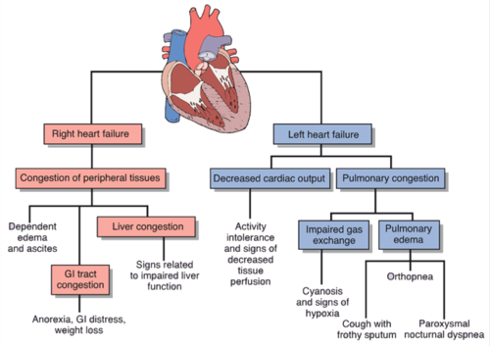
University of Basra
AL-Zahraa College of Medicine
Ministry of higher Education and Scientific Research

Slide 6
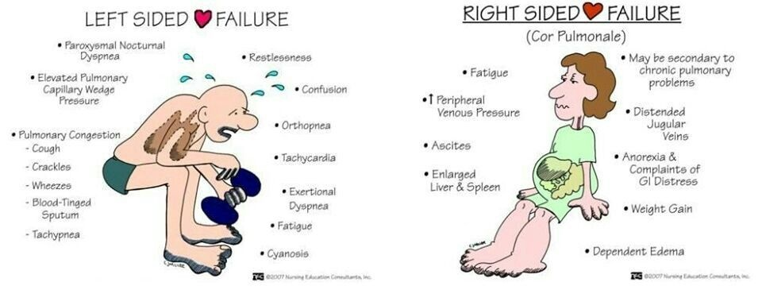
University of Basra
AL-Zahraa College of Medicine
Ministry of higher Education and Scientific Research

Slide 7
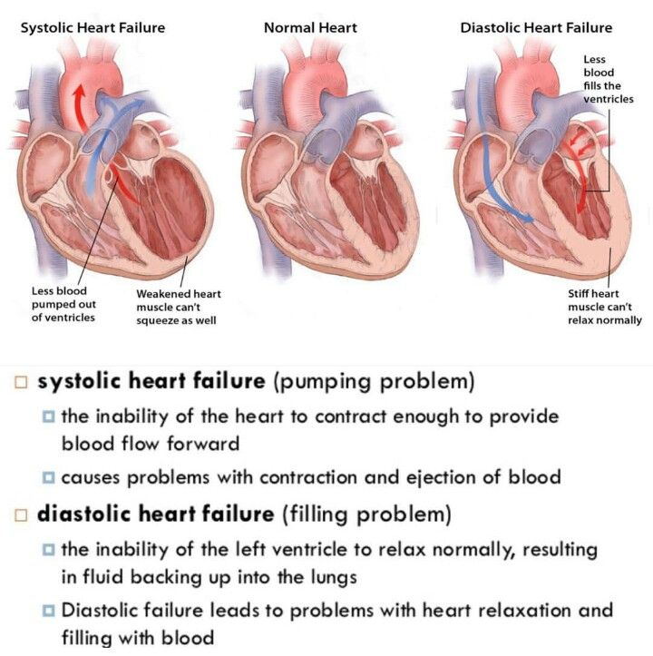
University of Basra
AL-Zahraa College of Medicine
Ministry of higher Education and Scientific Research

Slide 8
University of Basra
AL-Zahraa College of Medicine
Ministry of higher Education and Scientific Research
Characteristics | Diastolic heart failure (HFpEF) | Systolic heart failure (HFrEF)
Age | Frequently in elderly | All ages are effected (50-70 y)
sex | Frequently in female | frequently in male
Left ventricular ejection fraction | Normal (preserved)>55% | Reduced <55%
Left ventricular cavity size | Small or normal | Dilated
ECG | LA enlargement, LVH | Q wave IHD , poor R wave progression
Chest radiography | Congestion without cardiomegaly | Cardiomegaly with pulmonary congestion
Heart sound | S4 gallop | S3 gallop

Slide 9
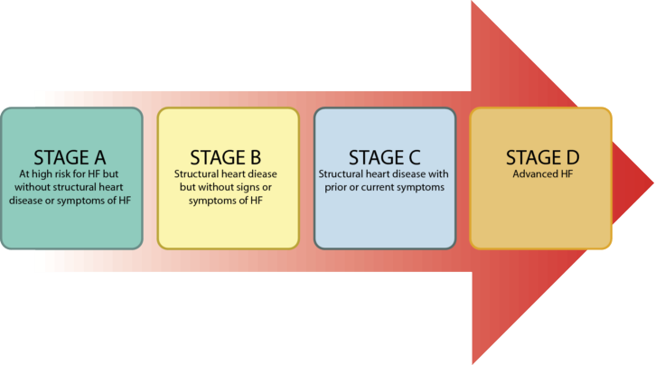
University of Basra
AL-Zahraa College of Medicine
Ministry of higher Education and Scientific Research

Slide 10
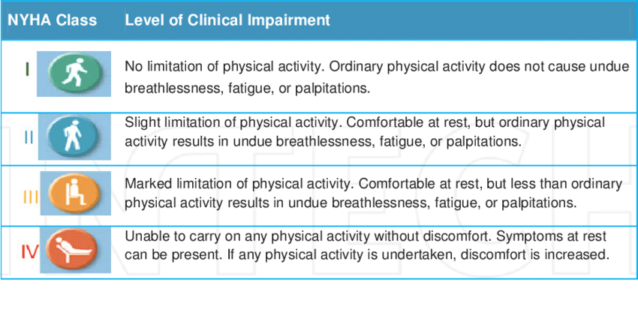
University of Basra
AL-Zahraa College of Medicine
Ministry of higher Education and Scientific Research

Slide 11
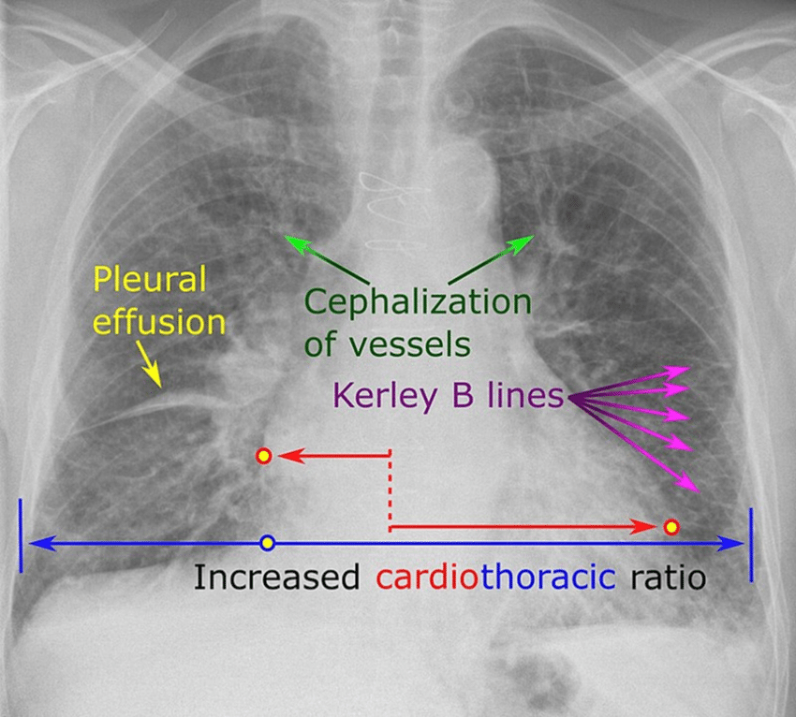
University of Basra
AL-Zahraa College of Medicine
Ministry of higher Education and Scientific Research

Slide 12
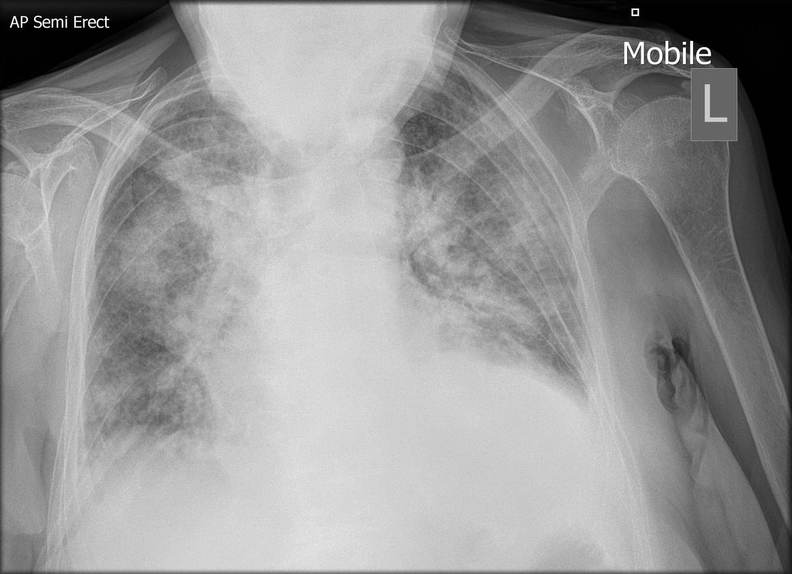
University of Basra
AL-Zahraa College of Medicine
Ministry of higher Education and Scientific Research

Slide 13
University of Basra
AL-Zahraa College of Medicine
Ministry of higher Education and Scientific Research
What are the ECG changes of heart failure ?

Slide 14
University of Basra
AL-Zahraa College of Medicine
Ministry of higher Education and Scientific Research
What is the value of echocardiography in evaluating patients with heart failure ?

Slide 15
University of Basra
AL-Zahraa College of Medicine
Ministry of higher Education and Scientific Research
What is the value of Ventricular natriuretic peptide in evaluating patients with heart failure ?

Slide 16
University of Basra
AL-Zahraa College of Medicine
Ministry of higher Education and Scientific Research
What's BNP?
Ventricular natriuretic peptide or brain natriuretic peptide (BNP), also known as B-type natriuretic peptide, is a hormone that is secreted predominantly by the ventricles, and reaches very high plasma concentrations in subjects with congestive HF or AHF. BNP is synthesized in the heart as a reaction to cardiac wall distension and stretching, and neurohormonal activation.
plasma NP levels are elevated in patients with acute myocardial infarction and LV dysfunction; this increase persists during late phases of cardiac remodeling.
Elevated peptide levels are directly correlated with prognosis, NYHA score, intra-ventricular pressure, pulmonary pressure, and inversely proportional to cardiac output

Slide 17
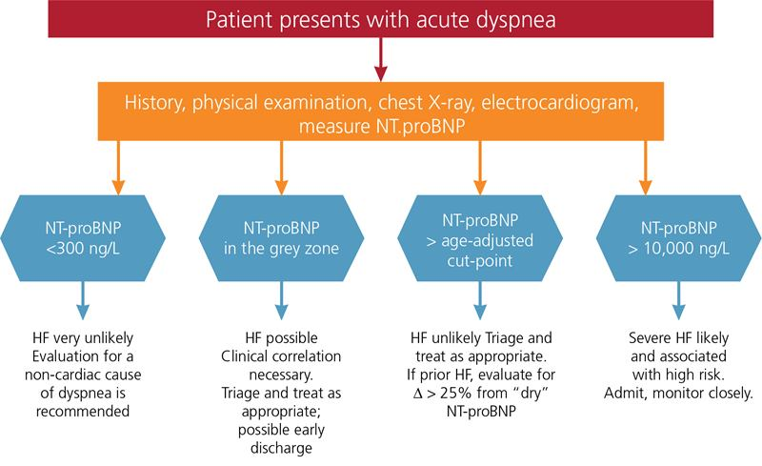
University of Basra
AL-Zahraa College of Medicine
Ministry of higher Education and Scientific Research

Slide 18
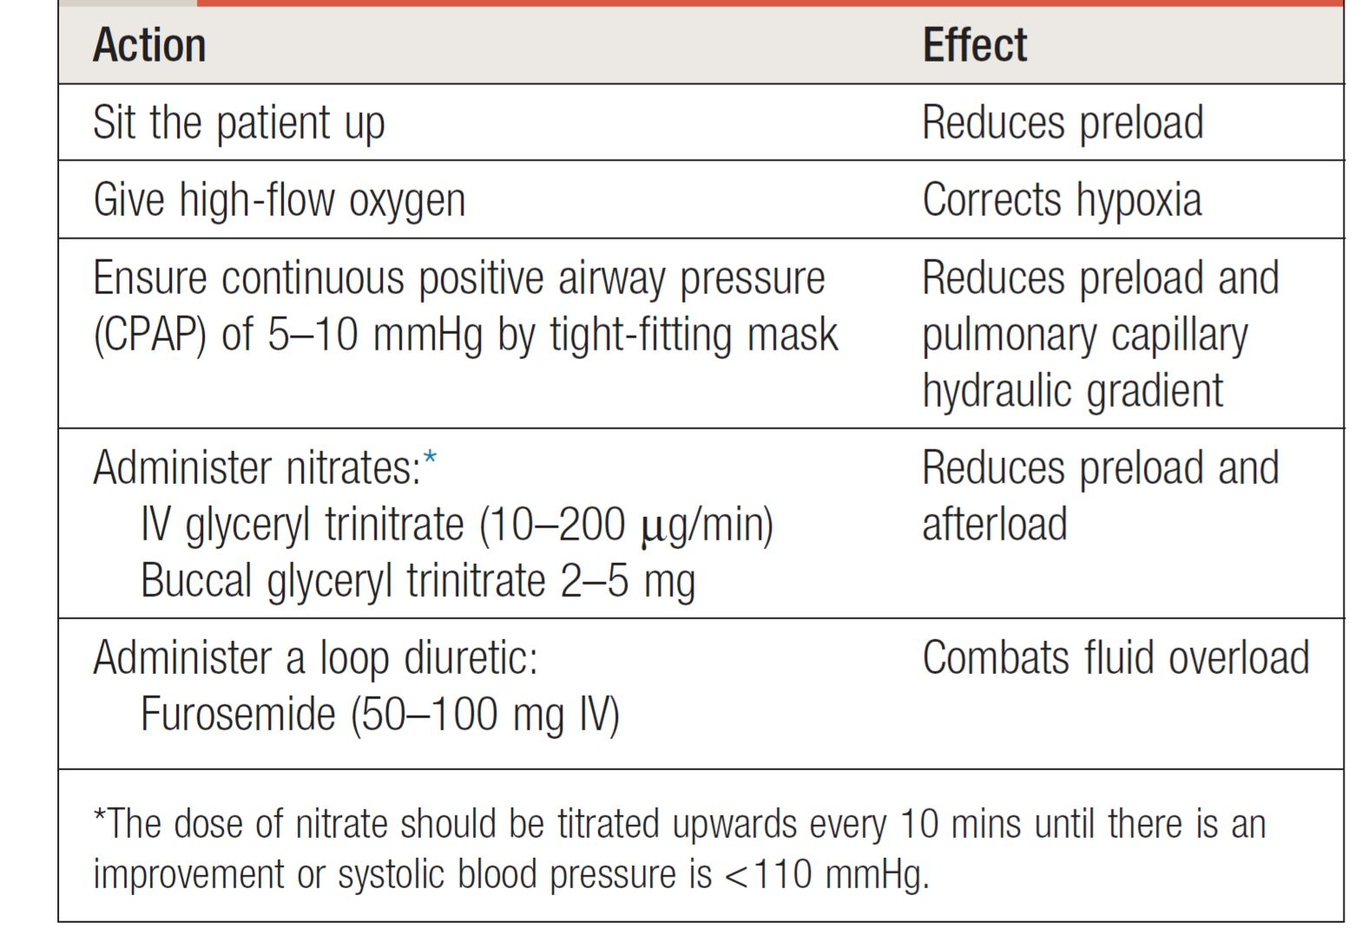
University of Basra
AL-Zahraa College of Medicine
Ministry of higher Education and Scientific Research
Management of acute pulmonary oedema

Slide 19
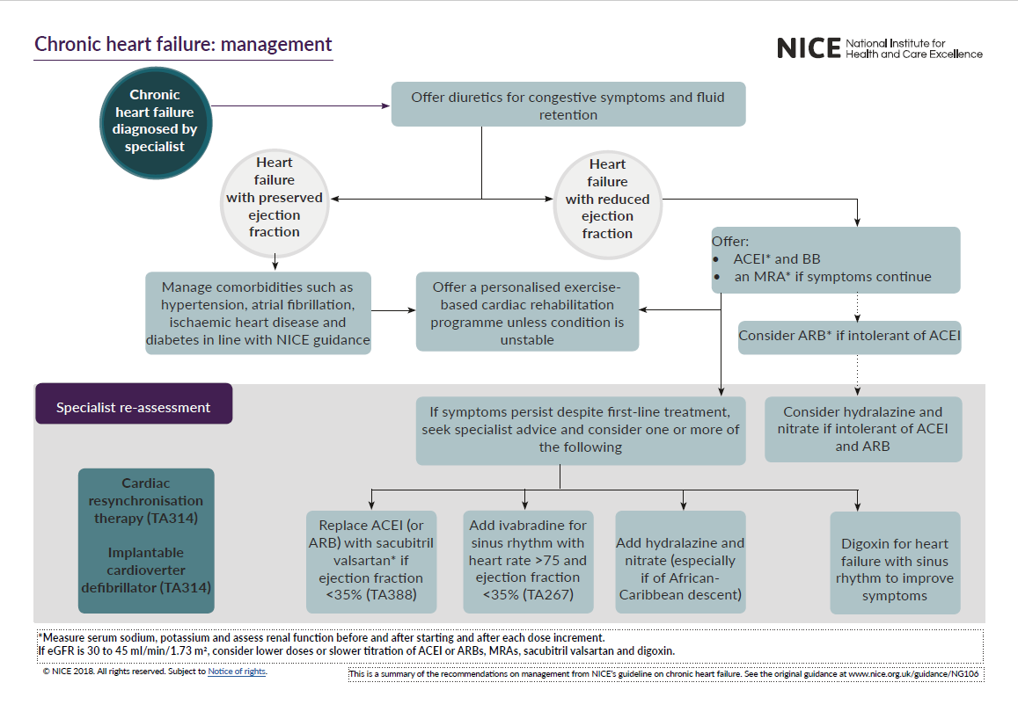
University of Basra
AL-Zahraa College of Medicine
Ministry of higher Education and Scientific Research

Slide 20
University of Basra
AL-Zahraa College of Medicine
Ministry of higher Education and Scientific Research
What are the drugs that improve survival in heart failure ??

Slide 21
University of Basra
AL-Zahraa College of Medicine
Ministry of higher Education and Scientific Research
Thank you

